Slide 1

Company X– Non Technical Presentation
Date: 22-06-2020
Presenter: Monisha Anila

Slide 2
Company X market share for it’s products is decreasing yearly by 10% contributing towards profits is unfavourable, requiring to stop producing least products and improve market strategies to reduce this impact in both short and long term.
!
Competitors using advanced technologies like ML,AI and IOT lead to decrease in 10% annual sales of last year.
Increased market demand products has also lead to increased competitions.
!
A strategy to be enforced to gain customers for profits.
Market Segment and Opportunity must be found for sales across the industries.
!
Economics concepts involved dashboard creation is compulsory work.
A customer strategy based on geographic and quantity.

Slide 3
The formation SMART problem statement and approaching with data visualisation methods.
What opportunities exist for X company a food industry to increase their profits by 15% in the next 6 months by improving product servicing?
Market Segment and Opportunity
Product Divestment

Slide 4
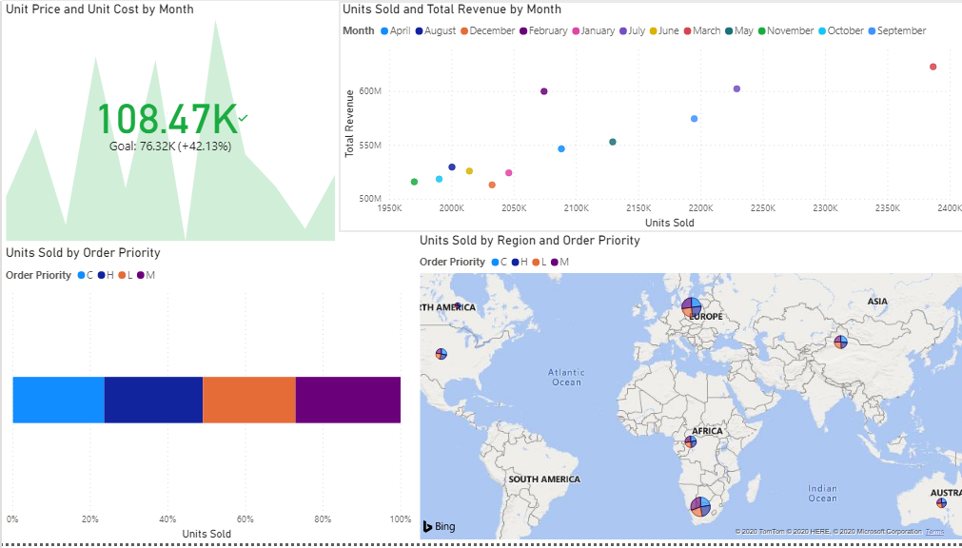
Plotting the data based on Order Priority for finding units sold according to Revenue, Unit Cost, Unit Price and geographically.
Key Insights
Unit Price is always higher than Unit Cost monthly up to 40%.
Equal sales distribution order priority.
Company X has wide range of customer base.
March, July, September and November months have 200k+ sales with $550M+ revenue.
Source: Company X Statistical Records

Slide 5
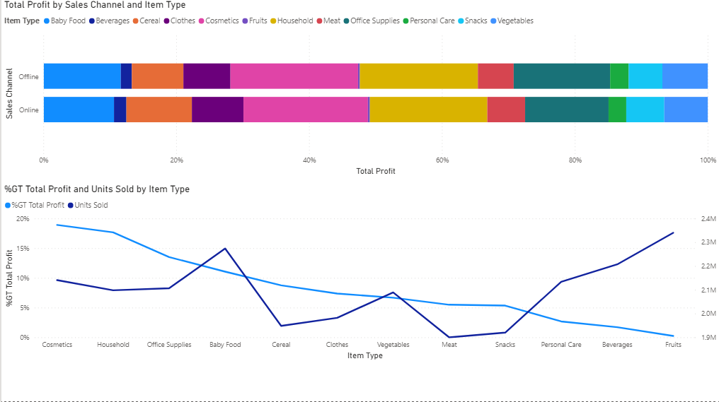
Further analysis of products category for market opportunities using profit as key variable.
Key Insights
Cereal and Snacks holds 15% profits with <5% of quantity according to Item Type.
Baby Food and Vegetables holds 10%-5% profits with 15%-10% quantity according to Item Type.
Cosmetics and House holds 40% profits with 20% quantity according to Item Type.
Source: Company X Statistical Records

Slide 6
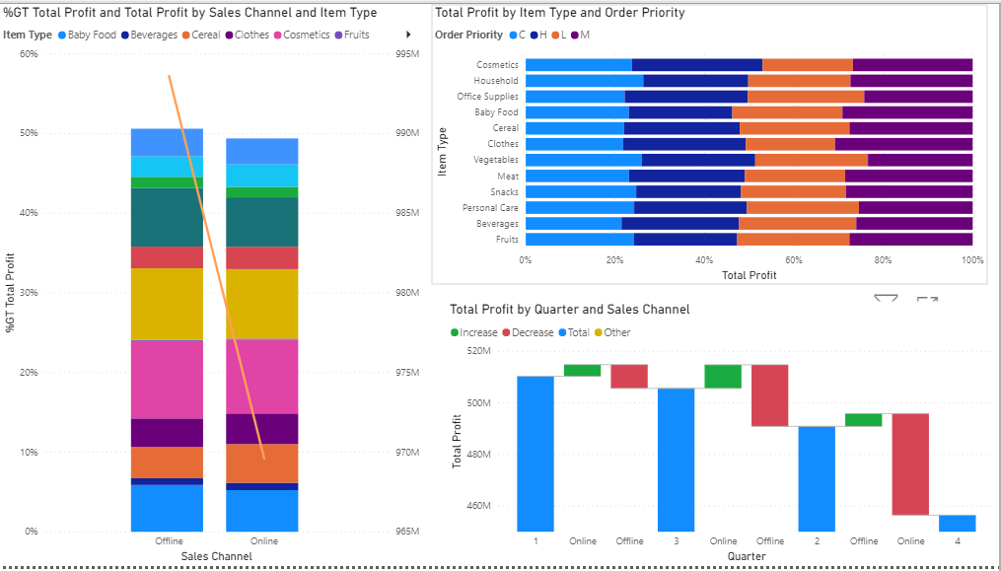
We found out the key variables(3) for profits to use them for predictive analysis.
Key Insights
Overarching Insights: Order Priority is the key profit driver. Critical order almost has 40% profits and Medium orders 20% profits. Seasonality(March, July, September and November) business almost contribute half of the overall profits.
Support points : Order Priority, Item Type and Sales Channel
Profit
Order Priority
Item Type
Sales Channel
Source: Company X Statistical Records

